Slide 1
Communication Skills
Writing Skills

Slide 2
09 January 2021
Session 1
Overview of Soft Skills
Communication Skills & Soft Skills
Why Write? – from Business Writing Skills
Session 2
Note Taking
Note Making

Slide 3
09 January 2021 (cont)
Objectives
Understand the importance of Soft Skills
Learn about the language skills – Writing
Grasp the dynamics of Note Taking and Note Making
Implement the principles of Note Taking and Note Making in learning situations

Slide 4
Context
Soft Skills
Employability Skills / HR Skills
People Skills
Life Skills
Interpersonal Skills
Vs Technical Skills [Hard Skills]

Slide 5
Challenges
Hard Skills/Technical Skills – Trainable / Core Competence and Specific; unique to your area of knowledge and expertise
versus
Soft Skills – Life-Learning / Package not Individual; Universal knowledge of how to act around other humans

Slide 6
Aspects
Communication Skills
Interpersonal Skills
Personality Development
Professional Ethics
Computer Skills
Management Skills
Positive Thinking
Critical Thinking and Analysis
Problem Solving

Slide 7
Definitions
Soft skills are interpersonal skills such as the ability to communicate well with other people and to work in a team
Desirable qualities for employment that do not depend on acquired knowledge: they include the ability to deal with people and a positive flexible attitude
Competencies associated with activities such as communication, problem-solving, and team-working considered by employers to be of very high importance. Includes loyalty, enthusiasm, punctuality, and a strong work ethic

Slide 8
Definitions (contd)
International Bureau of Education-UNESCO
A set of intangible personal qualities, traits, attributes, habits and attitudes also seen as transferable skills.
Examples of soft skills: empathy, leadership, sense of responsibility, integrity, self-esteem, self-management, motivation, flexibility, sociability, time management and making decisions.
Contrast to ‘hard’ skills that are considered as more technical, highly specific in nature and particular to an occupation and that can be (generally) taught more easily than soft skills.

Slide 9
Comments
Soft skills affect every aspect of your career from the moment you start applying for jobs. They’re often unspoken, but all employers expect that you understand what they require in a work environment.
Dr Marion Steel, Course Director for the Bachelor of Commerce at Deakin University, Melbourne, Australia

Slide 10
Comments (cont)
Many graduate students are so focused on developing expertise in their field that they may neglect to realize how important it is to actively work on skills like communication, time management, or conflict resolution. These skills are critical in the workplace, and being able to demonstrate them can really help a student stand out in today's competitive job market.
Stephanie Miller, MS Environmental Science & Research Trainee at US EPA (Environmental Protection Agency)

Slide 11
Prediction
A public interest study conducted by McDonald’s in the UK predicted that over half a million people will be held back from job sectors by 2020 due to their lack of soft skills

Slide 12
Simulation
Let’s take an example of Ms. X & Mr. Y.
Ms. X always listens patiently to her teammates & helps them to find solutions to their problems whereas Mr. Y does not give an ear to such problems & believes in solving his problems at the earliest even if his teammates are in trouble.
Ms. X is proactive in taking lead in projects, analyzing problems & critically finding solutions. Mr. Y on the other hand, always avoids any extra work & stresses over small troubles which might arise during a project, thus leading the whole team to failure.

Slide 13
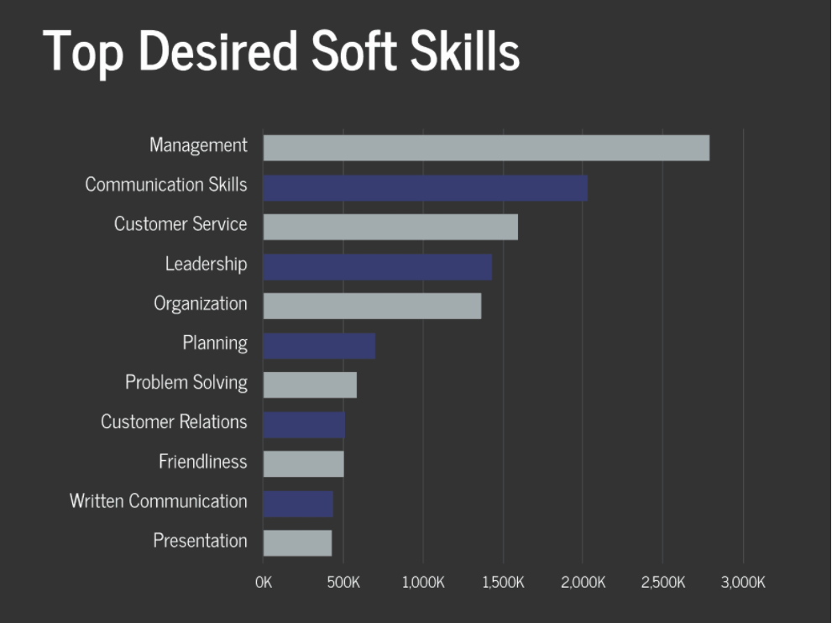
Soft Skills and Communication Skills

Slide 14
Remember
A good starting point:
listen to other people in conversation
respond to what they are saying
articulate yourself with clarity and in a simple manner
concentrate on your body language
think about eye contact
These things are taken for granted by many, but making a conscious effort to improve your communication abilities can be the cornerstone of your success

Slide 15
Training
Motivation / What do YOU Want? = Mindset
Practice
Exposure
Class room situations
Internship
Social situations
Equipping with information from newspapers, books, articles and the internet

Slide 16
Recommended Text
Dobrian, Joseph. Business Writing Skills: A Take-charge Assistant Book. AMACOM Books, 1998.

Slide 17
Why Write? – from Business Writing Skills
Writing good English is really not very hard
Badly written communications you've received:
"I wish I could figure out what this person is saying.“
Writing using clear, standard English will tell your reader that you care about the reaction you're going to get

Slide 18
Why Write? – from Business Writing Skills (cont)
The One Big Rule of Good Writing
Brevity, precision, and clarity and the greatest of these is clarity.
Why Write Well?
You'll be writing more, not less, as time goes on. English has become the international language of business. To communicate, you have to have good writing skills

Slide 19
Why Write? – from Business Writing Skills (cont)
Anyone can learn to be a good writer. It's like any other skill: To get good at it, you have to want to be good at it, and you have to practice a lot
Reading is as important as writing. It doesn't much matter what you read so long as you read well-written books. By reading good writing, you'll pick up all kinds of little tricks for making your own writing more interesting. You'll also expand your vocabulary and your understanding of the language

Slide 20
Training – Writing Skills
ABC of Communication
Accuracy
Brevity
Clarity

Slide 21
Training – Writing Skills (cont)
Steps to Good Writing
Draft
Revise
Polish

Slide 22
Training – Writing Skills (c0nt): from Business Writing Skills
Very informal:
Get back to me on this in a month or so, okay?
Informal:
Could you please get back to me on these proposals within a month's time?
Formal:
I hope you'll be able to respond to these proposals no later than a month from now.

Slide 23
Summary
Definitions of Soft Skills
Some training points on improving soft skills
Details from Business Writing Skills (“Why Write?”)
Some training points on improving communication

